Slide 1
Text Mining: Chinese Pop Song Lyrics

Slide 2


Marc Moskowitz’s core argument: Chinese pop songs are more feminine and convey more sense of “loneliness” than their western counterparts

Slide 3
Text Mining:
Chinese and American Pop Song Lyrics
I why: 1. challenge your “academic grandfather” and develop critical thinking
2. the highly cultural and poetic contents of Chinese pop lyrics
II Steps:
1. dataset building: work in pairs, each pair collect the lyrics of top 50 Chinese and American hits for 3 consecutive years, convert them into Microsoft word format, upload them to blackboard, the whole class will collect 1,500 Chinese hits and 1,500 American hits over the last 30 years; (any better method?)
2. use Voyant for text mining and visualization
1) compare: top 10 words of Chinese and American hits

Slide 4
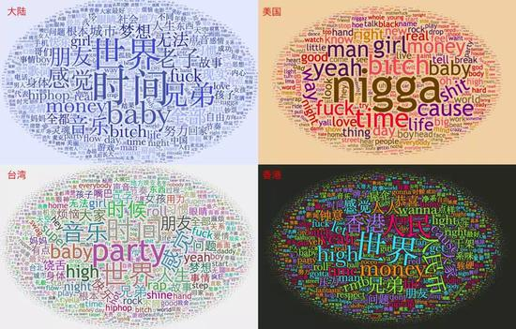
rappers’ top word cloud

Slide 5
Text Mining: Chinese Pop Song Lyrics
I why: 1. challenge your “academic grandfather” and develop critical thinking
2. the highly cultural and poetic contents of Chinese pop lyrics
II Steps:
1. dataset building
2. use Voyant for text mining and visualization
1) macro-comparison: top 10 words of Chinese and American hits
2) close reading of a word in context: i.e., “time” is frequently used in both Chinese and American hits, what other words are often associated with “time”? Does it mean in the specific context of Chinese and American lyrics?
3) give students the freedom to explore the word or topic they are interested in (animal or city names?)
3. use Tencent Open AI Platform for “Sentiment Analysis”: https://ai.qq.com/product/nlpemo.shtml

Slide 6
Text Mining: Chinese Pop Song Lyrics
I why: 1. challenge your “academic grandfather” and develop critical thinking
2. the highly cultural and poetic contents of Chinese pop lyrics
3. distant reading and close reading
II Steps:
1. dataset building
2. use Voyant for text mining and visualization
1) macro-comparison: top 10 words of Chinese and American hits
2) close reading of a word in context: i.e., “time” is frequently used in both Chinese and American hits, what other words are often associated with “time”? does it mean in the specific context of Chinese and American lyrics?
3) Give students the freedom to explore the word or topic they are interested in (animal or city names?)
3. use Tencent Open AI Platform for “Sentiment Analysis”: https://ai.qq.com/product/nlpemo.shtml
1) overall sentiment of Chinese and American hits
2) historical change of sentiment over the last 30 years
3) change of sentiment and change of GDP
4. Creativity and Performance: replace the lyrics of an American hit

Slide 7
Self-reflection:
1. teaching goal: critical thinking, integration of distant and close reading, cultural comparison, relationship between lyrical change and socioeconomic change
2. need more focus: suggestions?
3. need help with technology in dataset building, clustering, topical modeling

